Slide 2
UP and DOWN DMRs
UP regulated DMRs
DOWN regulated DMRs

Slide 3
TP53 UP and DOWN DMRs
TP53 UP DMRs
TP53 DOWN DMRs
80 regions
Add a fit line one for the mutant and one for the wt

Slide 4
SUZ12 UP and DOWN DMRs
SUZ12 UP DMRs
SUZ12 DOWN DMRs
144 regions

Slide 5
EZH2 UP and DOWN DMRs
EZH2 UP DMRs
EZH2 DOWN DMRs
181 regions

Slide 6
MYC UP and DOWN DMRs
MYC UP DMRs
MYC DOWN DMRs

Slide 7
MYCN UP and DOWN DMRs
MYCN UP DMRs
MYCN DOWN DMRs

Slide 8
E2F1 UP and DOWN DMRs
E2F1 UP DMRs
E2F1 DOWN DMRs

Slide 9
E2F4 UP and DOWN DMRs
E2F4 UP DMRs
E2F4 DOWN DMRs

Slide 10
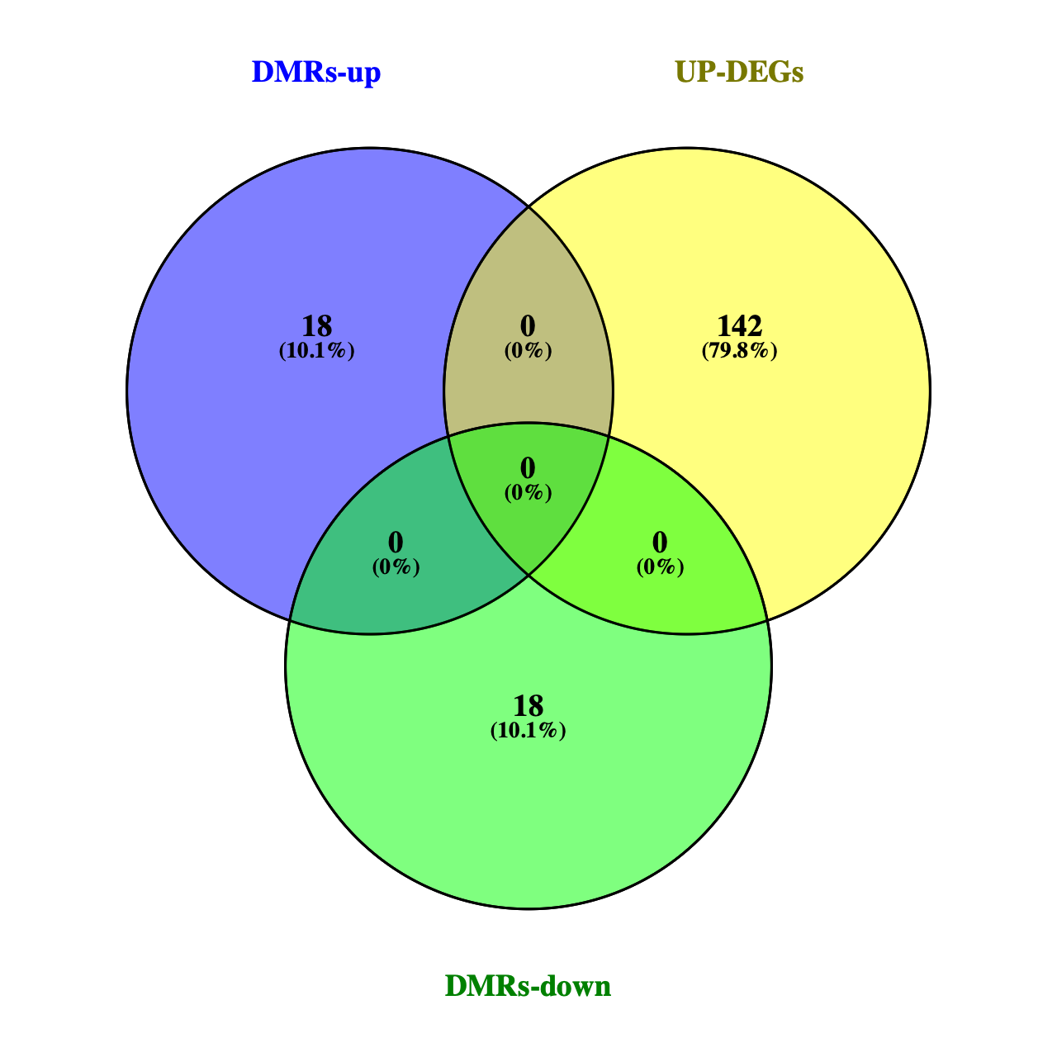
UP-regulated TFs between C1 vs C2
TFs identified in DMRs up
UP-regulated genes in C1
DMRTA2
EOMES
FOXA1
FOXD2
GSX2
ISL2
MEF2B
MTERF1
MXD3
NKX2-4
POU4F1
RUNX3
SIX2
SPIB
TBX2
TFAP2A
TFEC
VAX2
In yellow the TFs identified by Ray.
TFs identified in DMRs down

Slide 11
EOMES UP and DOWN DMRs
EOMES UP DMRs
EOMES DOWN DMRs
no, only up regions
16 regions

Slide 12
FOXA1 UP and DOWN DMRs
FOXA1 UP DMRs
FOXA1 DOWN DMRs
126 regions

Slide 13
RUNX3 UP and DOWN DMRs
RUNX3 UP DMRs
RUNX3 DOWN DMRs
no, only up regions
16 regions

Slide 14
SPIB UP and DOWN DMRs
SPIB UP DMRs
SPIB DOWN DMRs
no, only up regions
8 regions

Slide 15
TFAP2A UP and DOWN DMRs
TFAP2A UP DMRs
TFAP2A DOWN DMRs
108 regions

Slide 16
LGG
GBM + LGG
IDH(-)
IDH(+)
IDH(+)
IDH(-)

Slide 17
LGG
GBM + LGG
IDH(-)
IDH(+)

Slide 18
Analysis Turcan methylation data
CIMP + = 49
CIMP - = 32
Hyper and hypo methylated genes (model Adi)
CGI level: 43,438
GENE level: 2213

Slide 19
Hyper and hypo methylated genes genes (model Adi)
CGI level: 43,438
GENE level: 2213

Slide 20
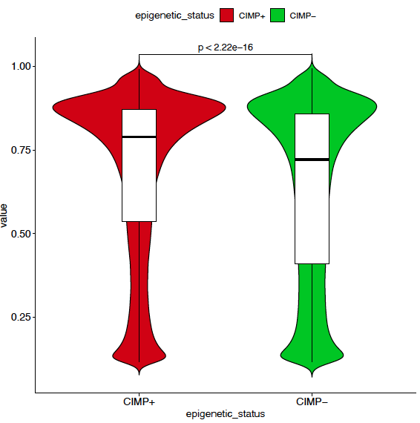
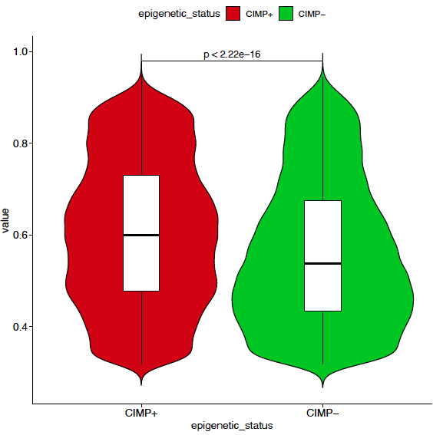
Hyper and hypo methylated genes genes (model Adi)
trimmed values

Slide 21
Analysis Turcan methylation data
CIMP + = 49
CIMP - = 32
Hyper (model Adi)
CGI level: 37723
GENE level: 1828

Slide 22
Hyper methylated genes genes (model Adi)
CGI level: 37723
GENE level: 1828

Slide 23
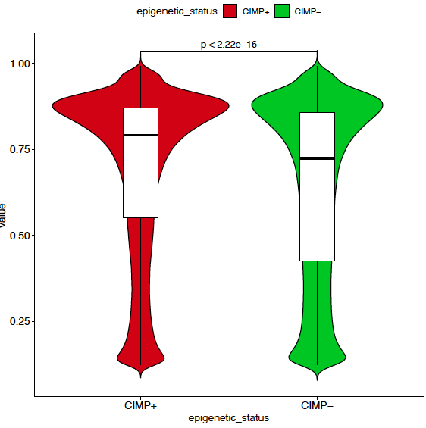

Hyper methylated genes genes (model Adi)
trimmed values
CGI level: 37723
GENE level: 1828

Slide 24
Analysis Turcan methylation data
CIMP + = 49
CIMP - = 32
hypo (model Adi)
CGI level: 6189
GENE level: 398

Slide 25
hypo methylated genes genes (model Adi)
CGI level: 6189
GENE level: 398

Slide 26
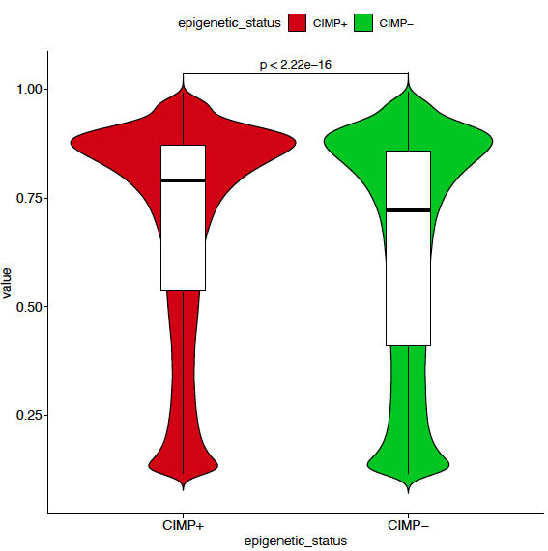
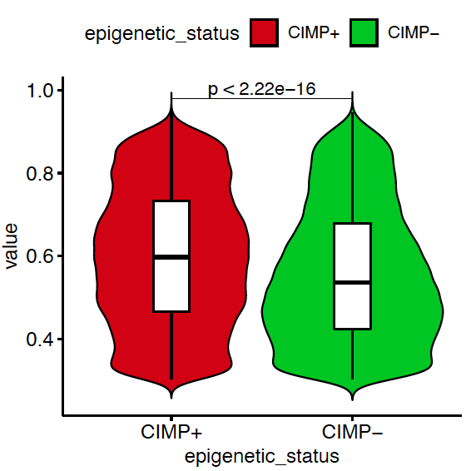
hypo methylated genes genes (model Adi) - trimmed
CGI level: 6189
GENE level: 398

Slide 27
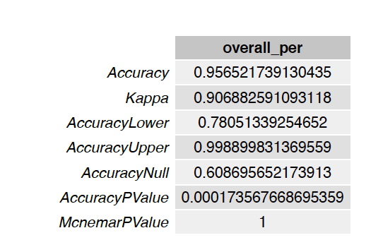
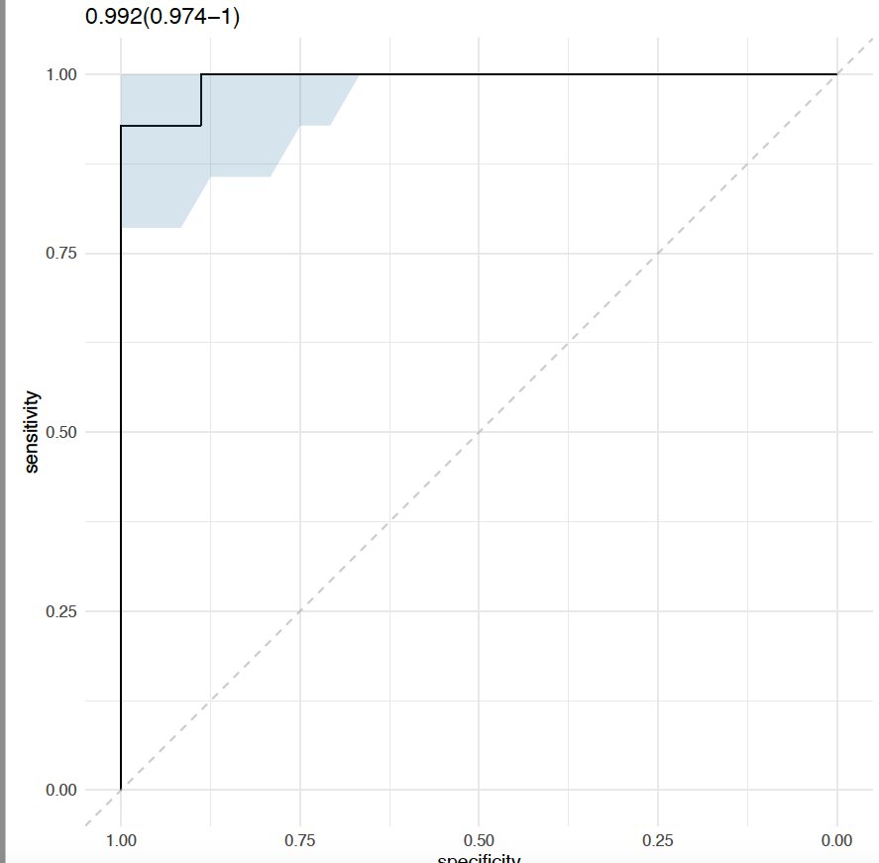
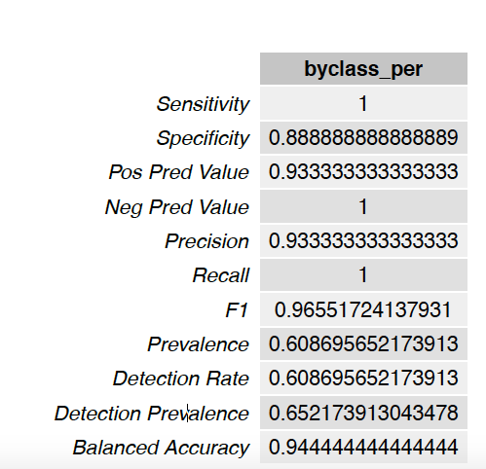
Analysis Turcan methylation data
Not include this
CIMP + = 49
CIMP - = 32
70:30
Training: 58
Test: 23

Slide 28
1974 (p.value= 0.05, LFC = |1|)
ALL regions 15814
Mu wt
Mu wt
Mu mut

Slide 29
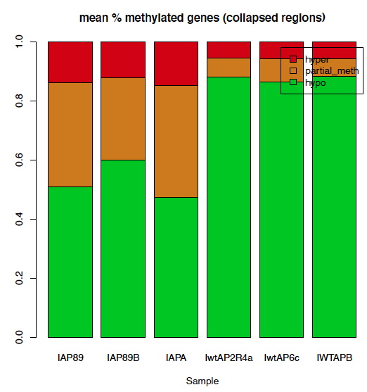
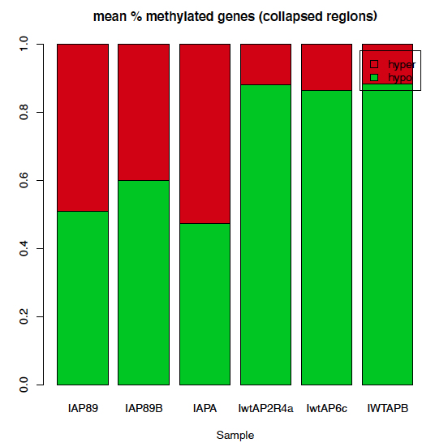
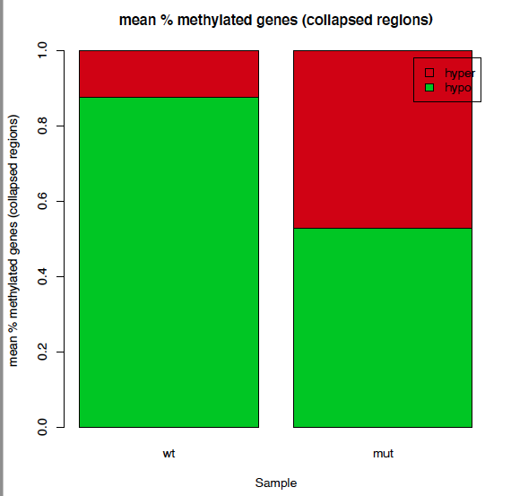
Barplot of the methylation status using the regions selected with the DMRs
- gene-level -
chr1
500
1000
Multiple CpG sites are collapsed together for one region

Slide 30
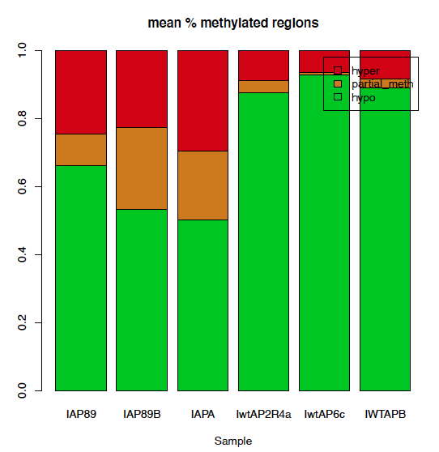
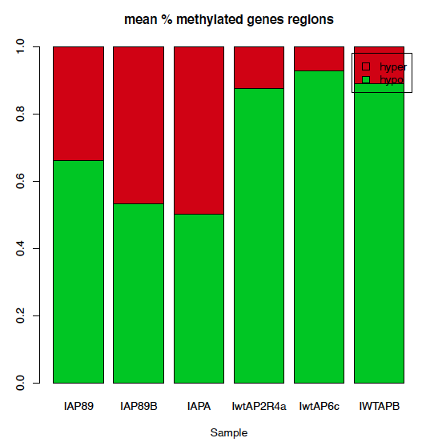
Barplot of the methylation status using the regions selected with the DMRs
- region-level -

Slide 31
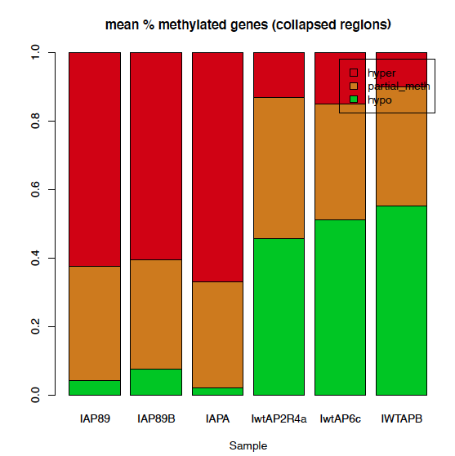
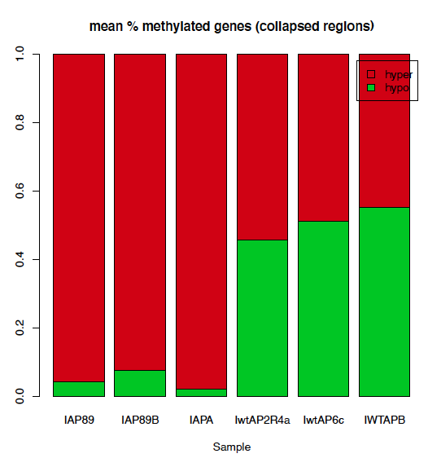
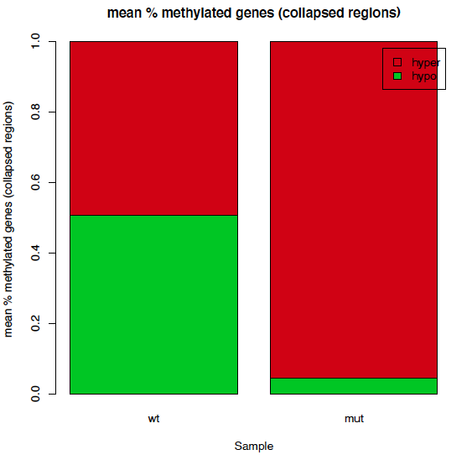
Barplot of the methylation status using the regions selected with their Dynamic (n=473) method
- gene-level -
I have recomputed the beta values from the raw files.

Slide 32
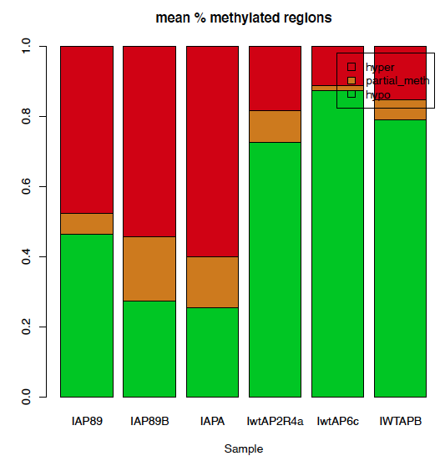
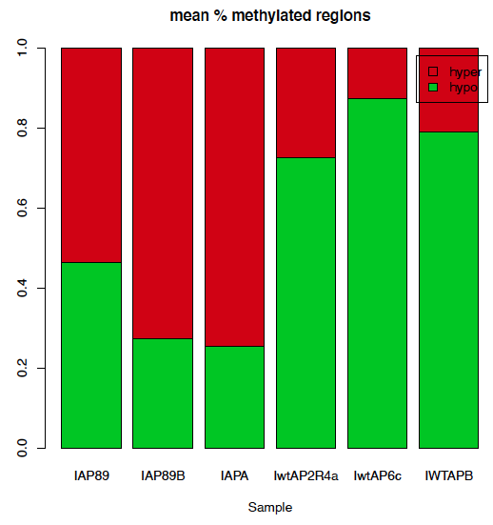
Barplot of the methylation status using the regions selected with they Dynamic (n=473) method
- regions level -
chr1
500
1000
Multiple CpG sites are considered as a single entity
I have recomputed the beta values from the raw files.

Slide 33
Overlap between differential methylated regions
Turcan and Adi (hyper and hypo)
Different “probeset ID” are related with the same genes.
Probeset ID | Symbol | Normalized fold change (mut/wt) | Delta-beta (P40 mut vs P40 wt) | Chromosome | Mapinfo | Accession | UCSC Refgene group | Relation to UCSC CpG island | Q value
cg00000236 | VDAC3 | 1.6772 | 0.03042 | 8 | 4.23E+07 | NM_005662;NM_001135694 | 3'UTR;3'UTR |  | 0.0465849 | Hyper
cg16759579 | VDAC3 | -1.85223 | -0.034855 | 8 | 4.22E+07 | NM_005662;NM_001135694 | 5'UTR;5'UTR | S_Shore | 0.0391234 | hypo

Slide 34
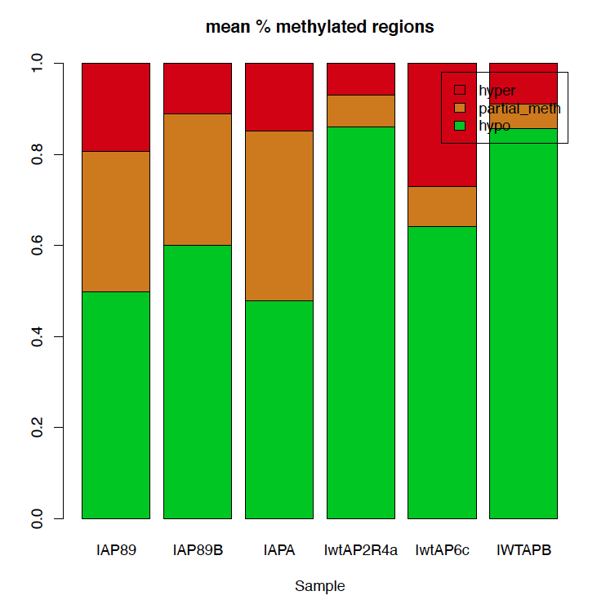
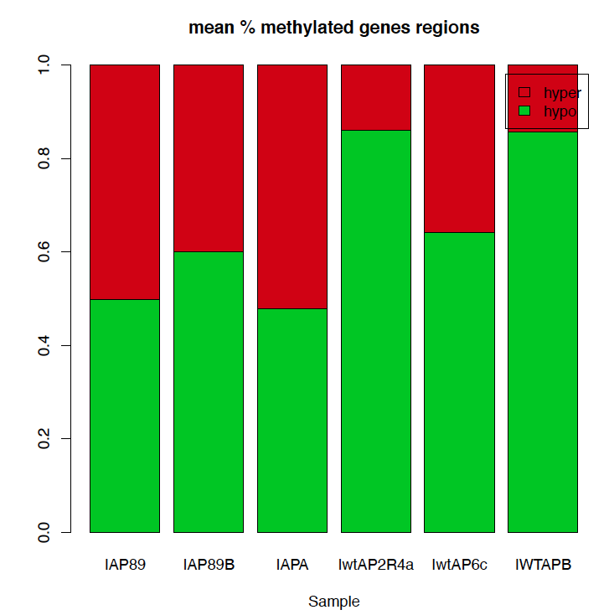
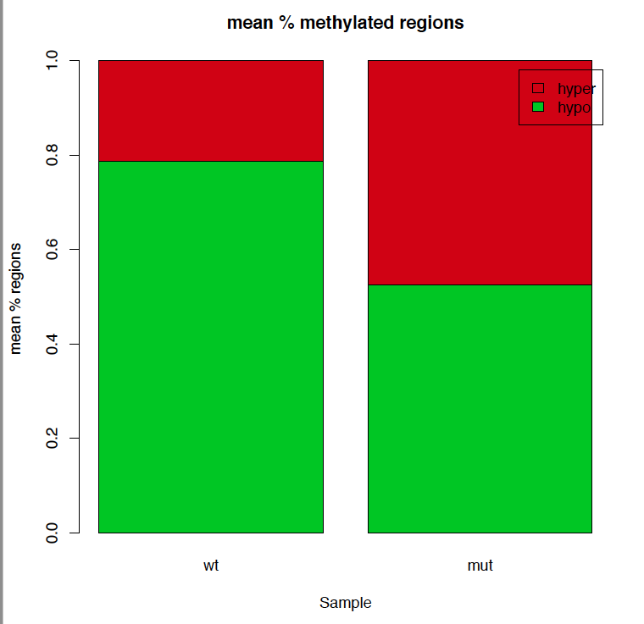
% of hyper/partial methylated, hypo-methylated regions defined using the
regions defined without Canada approach )

Slide 35
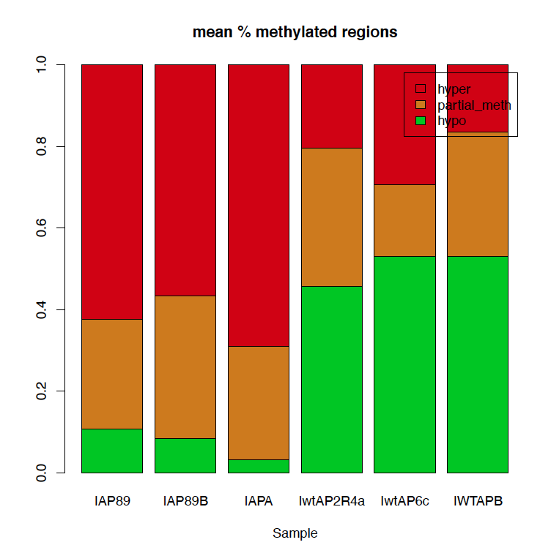
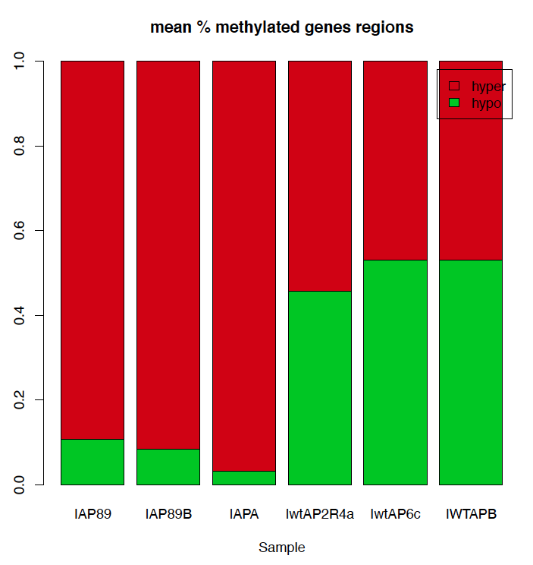
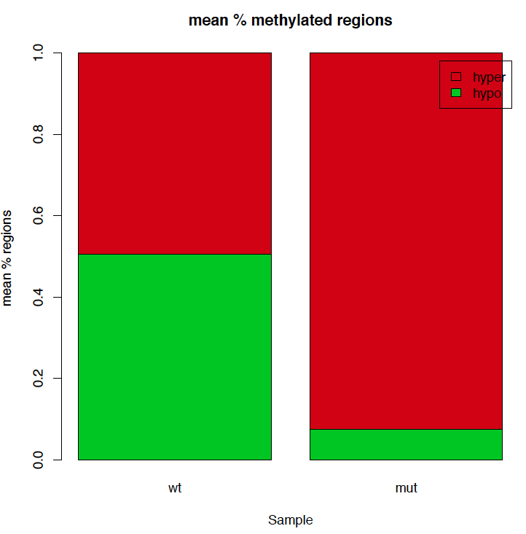
% of hyper/partial methylated, hypo-methylated regions defined using the
Dynamic approach (Canada).
Processing: material and methods Adi

Slide 36
> apply(unfiltered_with_logFC[,c(2:7)],2,mean)
IwtAP2R4a IwtAP6c IWTAPB IAP89 IAP89B IAPA
7.363904 7.293620 7.792526 8.370482 8.496204 8.064124
> apply(matrix_DMRs,2,checkMethMatrix)
$IwtAP2R4a
hyper hypo
1 0.1896421 0.8103579
$IwtAP6c
hyper hypo
1 0.2234096 0.7765904
$IWTAPB
hyper hypo
1 0.2276464 0.7723536
$IAP89
hyper hypo
1 0.2915138 0.7084862
$IAP89B
hyper hypo
1 0.2668522 0.7331478
$IAPA
hyper hypo
1 0.3042873 0.6957127

Slide 37
> apply(meth.levelsm,2,checkMethMatrix)
$IAP89
hyper hypo
1 0.7946528 0.2053472
$IAP89B
hyper hypo
1 0.7034886 0.2965114
$IAPA
hyper hypo
1 0.8030816 0.1969184
$IwtAP2R4a
hyper hypo
1 0.6702875 0.3297125
$IwtAP6c
hyper hypo
1 0.5715711 0.4284289
$IWTAPB
hyper hypo
1 0.6038204 0.3961796

